Slide 1
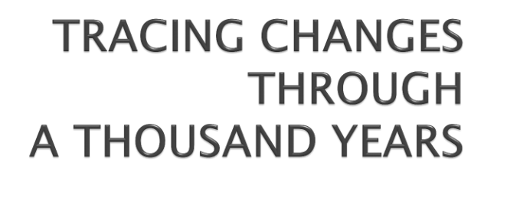
CHAPTER-1
HISTORY

Slide 2
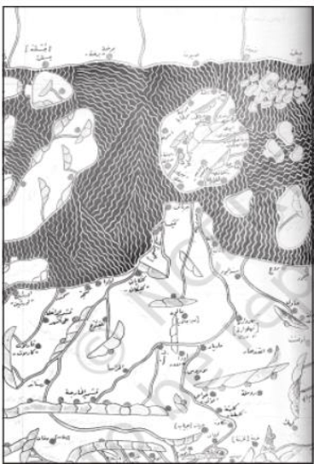
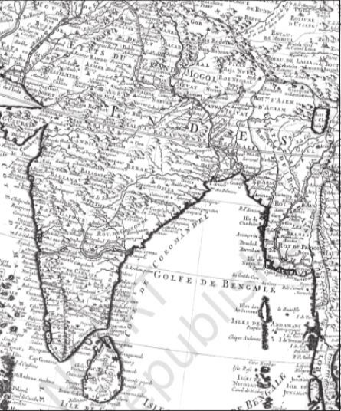

Slide 3
If the context in which information is produced changes with time, what
about language and meanings? Historical records exist in a variety of
languages which have changed considerably over the years.
Take the term “Hindustan”, for example. Today we understand it as
“India”, the modern nation-state. When the term was used in the
thirteenth century by Minhaj-i-Siraj, a chronicler who wrote in Persian,
he meant the areas of Punjab, Haryana and the lands between the
Ganga and Yamuna.
Take, for example, a simple term like “foreigner”.

Slide 4
You will notice some continuity in the sources used by historians for the
study of this period. They still rely on coins, inscriptions, architecture
and textual records for information. But there is also considerable
discontinuity.
People used it to write holy texts, chronicles of rulers, letters and
teachings of saints, petitions and judicial records, and for registers of
accounts and taxes
Manuscripts were collected by wealthy people, rulers, monasteries
and temples. They were placed in libraries and archives. These
manuscripts and documents provide a lot of detailed information to
historians but they are also difficult to use.

Slide 5
The study of the thousand years between 700 and 1750 is a huge
challenge to historians largely because of the scale and variety of
developments that occurred over the period.
At different moments in this period new technologies made their
appearance – like the Persian wheel in irrigation, the spinning wheel in
weaving, and firearms in combat. New foods and beverages arrived in
the subcontinent – potatoes, corn, chillies, tea and coffee.
This was also a period of great mobility. Groups of people travelled
long distances in search of opportunity.
One group of people who became important in this period were the
Rajputs, a name derived from “Rajaputra”, the son of a ruler.

Slide 6
Other groups of people such as the Marathas, Sikhs, Jats, Ahoms and
Kayasthas (a caste of scribes and secretaries) also used the opportunities
of the age to become politically important.
Changes in their habitat forced many forest-dwellers to migrate.
Others started tilling the land and became peasants.
Some possessed more productive land, others also kept cattle, and
some combined artisanal work with agricultural activity during the lean
season. As society became more differentiated, people were grouped
into jatis or sub-castes and ranked on the basis of their backgrounds
and their occupations.

Slide 7
Large states like those of the Cholas (Chapter 2), Tughluqs (Chapter
3) or Mughals (Chapter 4) encompassed many regions.
By 700 many regions already possessed distinct geographical
dimensions and their own language and cultural characteristics.
Occasionally dynasties like the Cholas, Khaljis, Tughluqs and
Mughals were able to build an empire that was pan-regional –
spanning diverse regions.
When the Mughal Empire declined in the eighteenth century, it
led to the re-emergence of regional states

Slide 8
It was during this period that important changes occurred in what we
call Hinduism today. These included the worship of new deities, the
construction of temples by royalty and the growing importance of
Brahmanas, the priests, as dominant groups in society.
One of the major developments of this period was the emergence of
the idea of bhakti – of a loving, personal deity that devotees could
reach without the aid of priests or elaborate rituals.
Merchants and migrants first brought the teachings of the holy Quran
to India in the seventh century. Muslims regard the Quran as their
holy book and accept the sovereignty of the one God.
Many rulers were patrons of Islam and the ulama – learned
theologians and jurists. And like Hinduism, Islam was interpreted in a
variety of ways by its followers.

Slide 9
The study of time is made somewhat easier by dividing the past
into large segments – periods – that possess shared characteristics.
In the middle of the nineteenth century British historians divided
the history of India into three periods: “Hindu”, “Muslim” and
“British”.
Moreover, the “medieval” period is often contrasted with the
“modern” period. “Modernity” carries with it a sense of material
progress and intellectual advancement. This seems to suggest that
the medieval period was lacking in any change whatsoever.
During these thousand years the societies of the subcontinent were
transformed often and economies in several regions reached a level
of prosperity that attracted the interest of European trading
companies.

Slide 10
New and Old Terminologies
Historians and their sources
New social and political Groups
Region and empire
Old and new religions
Historical Periods

